Slide 1
A complete, ultra-low input RNA-seq solution for full-length transcriptome analysis and RNA counting
Andrew Farmer, PhD
CSO/Head of R&D at Takara Bio USA

Slide 2
Takara Bio Group worldwide locations
Takara Bio Inc.
Corporate Headquarters: Kusatsu, Shiga, Japan
Worldwide affiliates
Takara Bio Europe AB (Gothenburg)
Takara Bio Europe S.A.S. (Paris)
Takara Bio USA, Inc. (San Jose)
Takara Biomedical Technology Co. Ltd. (Beijing)
Takara Biotechnology Co. Ltd. (Dalian)
Takara Korea Biomedical Inc. (Seoul)
DSS Takara Bio India Pvt. Ltd. (New Delhi)
Additional facilities
Center for Gene and Cell Processing (Kusatsu)
Stem Cell Research & Manufacturing (Gothenburg)
Satellite offices (Ann Arbor, Madison, Tokyo)
>1,500 employees worldwide
Notes:
For over 50 years, Takara Bio has been committed to helping scientists break new ground with our innovative technologies. We are a part of Takara Bio Inc., a world leader in biotechnology research and development based out of Shiga, Japan. Our North America office is headquartered in San Jose, CA, where we do most of our R&D, marketing, quality assurance, and ecommerce. Our other NA locations in Ann Arbor, MI, and Madison, WI, contribute to our research, logistics, and outreach programs.

Slide 3
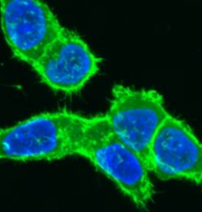
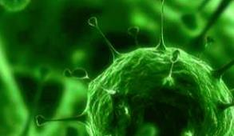
Our core capabilities
Automation solutions
Cloning
Gene delivery: transfection, transduction
Gene expression regulation
Genetic screening
Genome editing, gene editing
Next-gen sequencing: transcriptomics, genomics, targeted sequencing, and automation
Nucleic acid purification
PCR, qPCR, RT-PCR
Protein expression, purification
Protein-protein interactions
Stem cell research
Visualization: fluorescent proteins, antibodies

Slide 4
Evolution of Takara Bio single-cell SMART-Seq® technology
Plate-based mRNA-seq
SMART-Seq mRNA (with UMIs)*
SMARTer UL HV
SMARTer®
Ultra® Low
SMARTer UL v3
SMART-Seq Single Cell
SMART-Seq v4
SMART-Seq
Single Cell PLUS
SMART-Seq v4 3′DE
SMART-Seq v4 HT
2011
2012
2013
2014
2015
2016
2017
2018
2019
2020
2021
2022
2023
SMART-Seq ICELL8 v2
SMARTer UL for Fluidigm® C1™
SMART-Seq v4 for C1
SMART-Seq ICELL8® v1
SMART-Seq Pro
Automated mRNA-seq
*Product coming soon

Slide 5
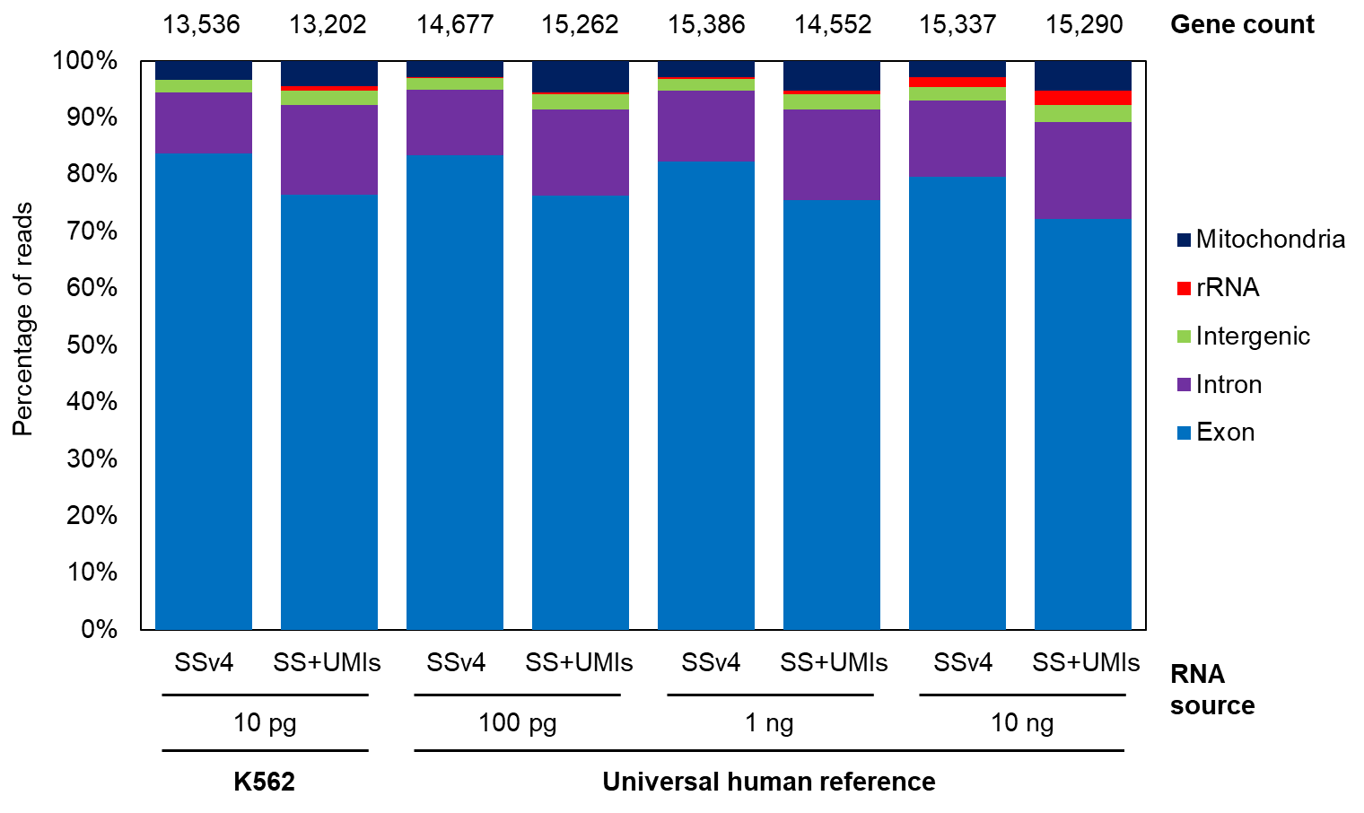
A new SMART-Seq method: SMART-Seq v4 vs. SMART-Seq mRNA (with UMIs)
Full-length mRNA-seq methods combine high sensitivity with allele-resolved expression
Current limitations of full-length mRNA-seq are either:
Absence of UMIs
Lack of a complete, end-to-end solution that includes bioinformatic analysis
Notes:
We developed a new complete SMART-Seq solution
Incorporates UMIs, our novel library prep method, and Cogent™ NGS analysis software
SMART-Seq mRNA (with UMIs) (SS+UMIs) demonstrates sensitivity comparable to SSv4. Gene count and read distribution across major RNA-seq output components for SSv4 and the SS+UMIs workflow. To evaluate the performance of the SS+UMIs workflow compared to the SSv4 workflow, each method was used to create sequencing libraries from K562 RNA (10 pg) or three different amounts of universal human reference (UHR) RNA (100 pg, 1 ng and 10 ng). The resulting cDNA libraries were sequenced on an Illumina platform and data was processed using CogentAP. The average gene count for each condition is shown above the corresponding bar. n=3 for all conditions.

Slide 6
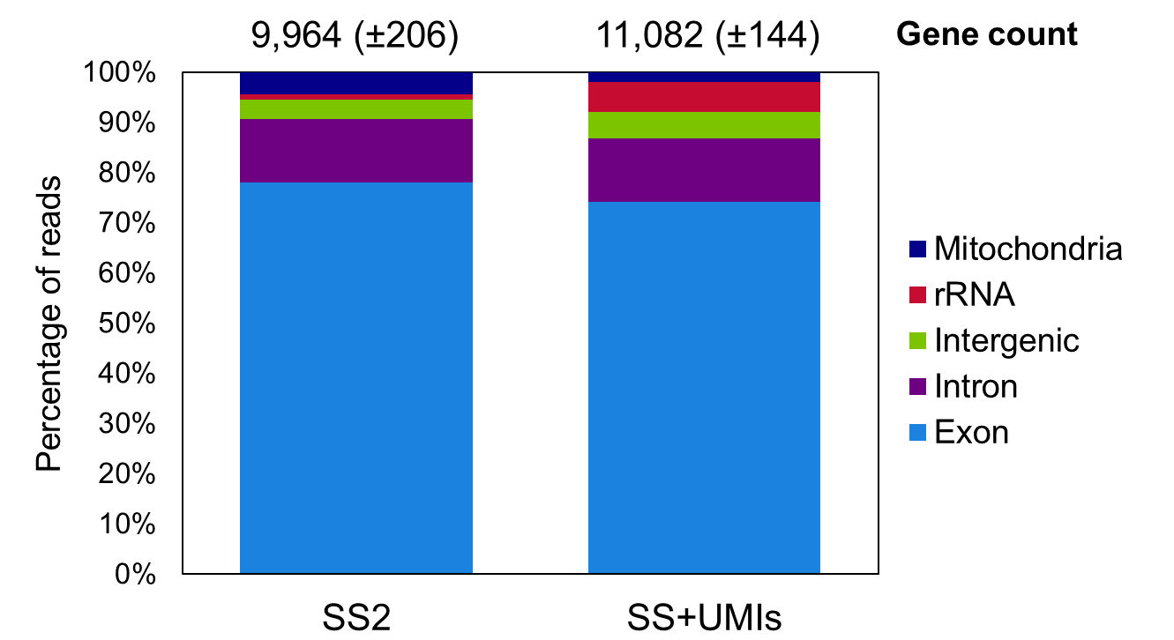
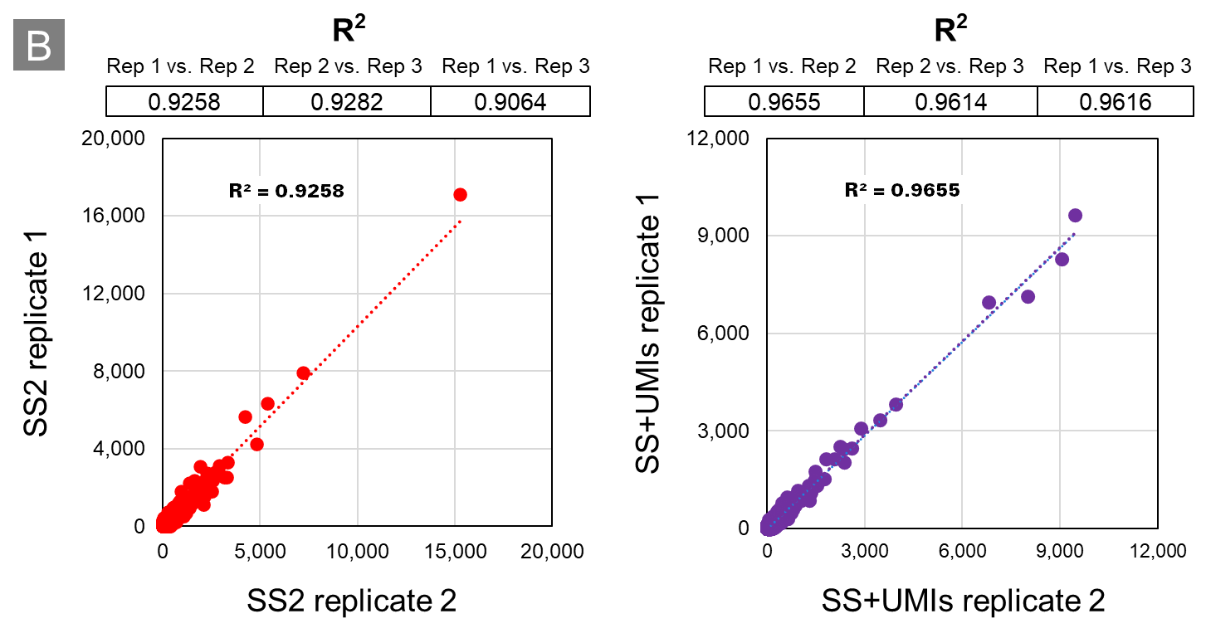
A new SMART-Seq method: SS2 vs. SMART-Seq mRNA (with UMIs)
Full-length mRNA-seq methods combine high sensitivity with allele-resolved expression
Current limitations of full-length mRNA-seq are either:
Absence of UMIs
Lack of a complete, end-to-end solution that includes bioinformatic analysis
Notes:
SS+UMIs outperforms SS2 in terms of sensitivity and reproducibility. Panel A. Gene count and read distribution across major RNA-seq output components for the SS+UMIs workflow and SS2. cDNA was generated from 10 pg UHR RNA using the SS+UMIs method or the SS2 method. Then, The SS+UMIs cDNA was prepared for sequencing using the SMART-Seq Library Preparation Kit and The SS2 cDNA was prepared for sequencing using the Nextera XT DNA Library Prep Kit (Illumina). Libraries from both were pooled, sequenced, and downsampled to 1.2 million reads. The average gene count for each condition is shown above the corresponding bar. n=3 for all conditions. Panel B. Absolute read counts for each gene matrix between each replicate pair for SS2 and SS+UMIs were plotted, and regression analysis was performed. The R² values were consistently higher for the SS+UMIs workflow using the SMART-Seq Library Preparation Kit. Example XY plots for both SS2 and SS+UMIs are shown. All data analysis was performed with CogentAP.

Slide 7
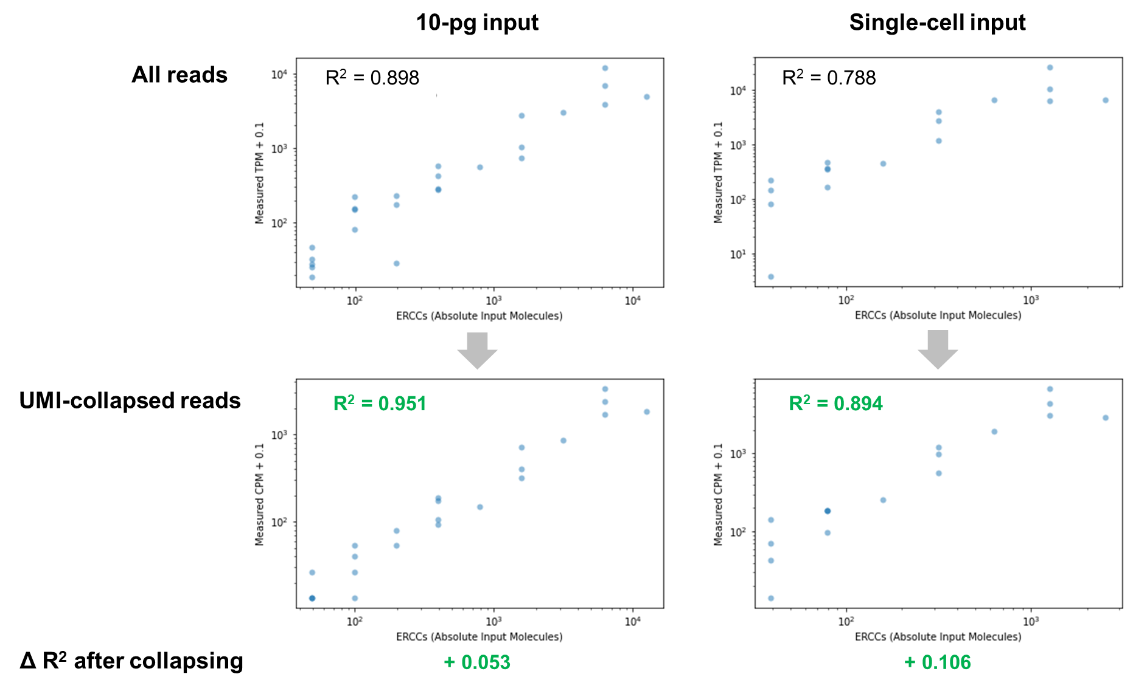
Use of UMIs reduces PCR duplications and increases sensitivity at single-cell inputs
Notes:
SS+UMIs reduces PCR duplications and allows for RNA counting. 10 pg of input RNA or a RNA from a single cell was spiked with ERCC control RNA, and libraries were prepared using the SS+UMIs method. Libraries were sequenced and then analyzed using CogentAP. The measured TPM or CPM was plotted against the absolute number of input molecules from the ERCC spike-in and regression analysis was performed. There is a significant increase in the R² with the collapse of UMIs, indicating addition of UMIs to the SSv4 workflow leads to a reduction of PCR duplications and enables more accurate RNA counting.

Slide 8
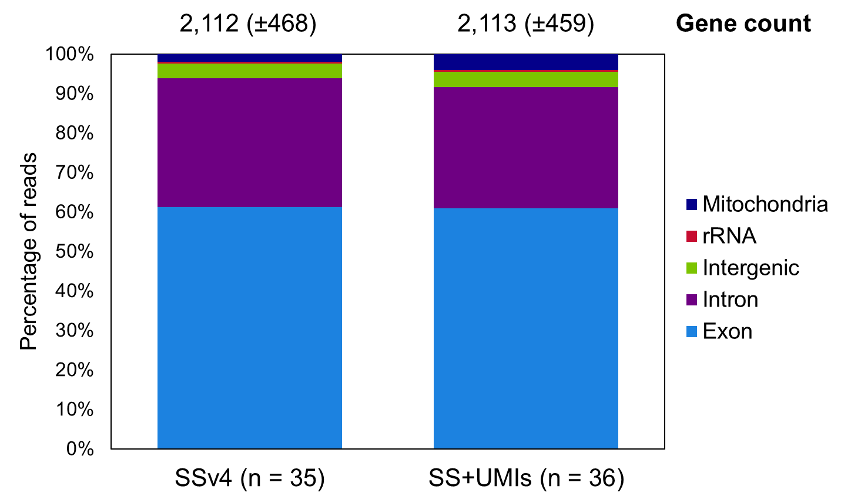
Use of UMIs reduces PCR duplications and has comparable sensitivity at single-cell inputs
Notes:
SS+UMIs outperforms SSv4 at single-cell input levels. Single peripheral blood mononuclear cells (PBMCs) were sorted into plates and sequencing libraries were produced using either SSv4 or the SS+UMIs workflow. Libraries were then pooled, sequenced, and downsampled to 900,000 reads for analysis. The read distributions and gene counts for SSv4 and SS+UMIs were comparable.

Slide 9
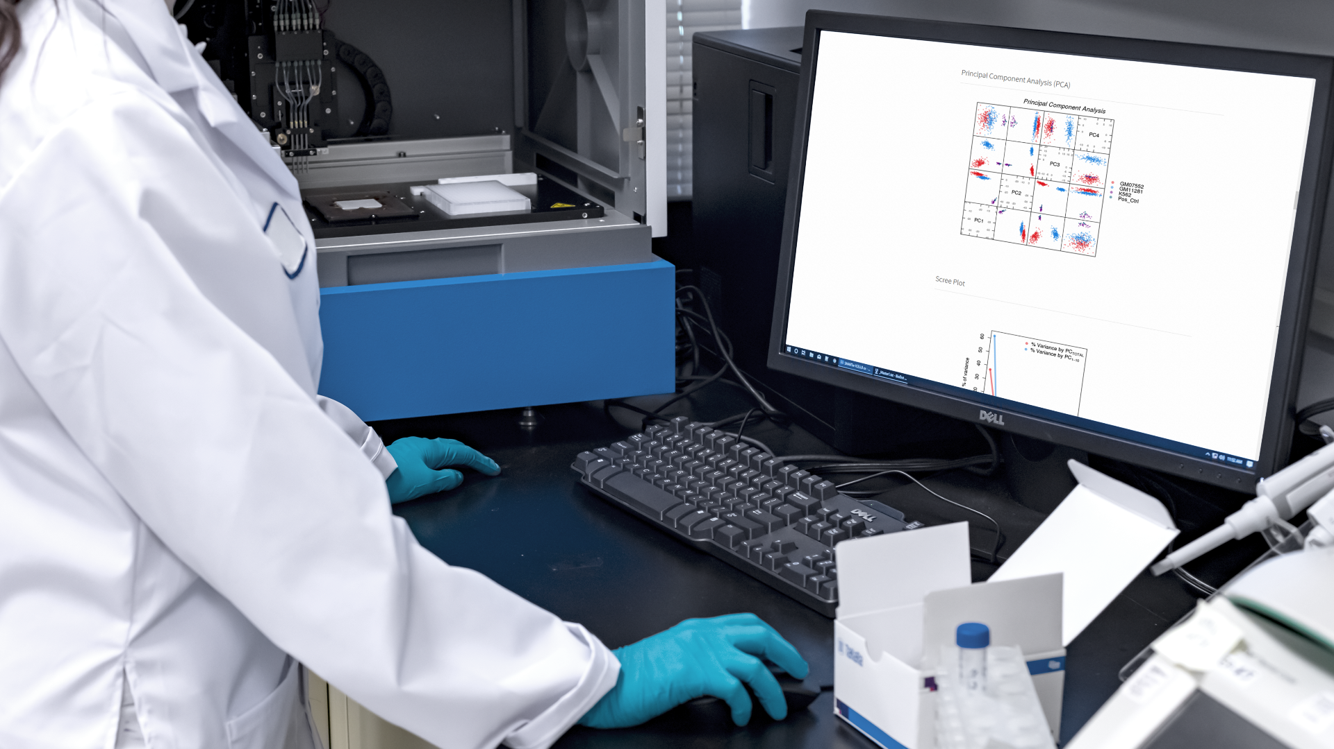
Conclusions: a complete, robust, RNA-counting strategy
UMIs allow for RNA counting without compromising data quality
Outperforms both SSv4 and SS2
Compatible with automation systems
SMART-Seq mRNA (with UMIs) is robust across a range of inputs, from single-cell inputs to 10 ng RNA
Visit me at Booth 204/206 to discuss this workflow in more detail and to see more data.

